Slide 1
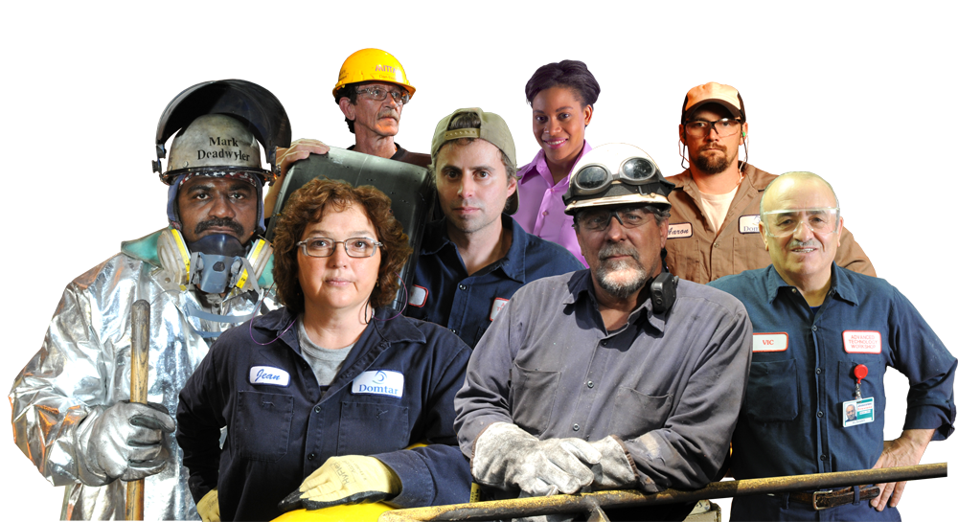
Forward Together: Building An Effective Union
Under Right To Work For Less

Slide 2
Open Shop/RTW Laws?
These laws are not put into place to help workers.
They are put into place to weaken Unions, which makes it easier for Companies/Government agencies to take advantage of their workers!

Slide 3
How Does Right to Work/Open Shops affect Unions?
Unions are the only organization in the US that are required by law to provide a service to individuals for free!
The “Duty of Fair Representation Law” requires Unions to represent all Bargain Unit employees equally regardless of their membership status.
This means the Union must bargain and process grievances of non-members just like it does for its membership.

Slide 4
Why do workers in an open shop choose to become USW members?
General attitude is good toward Union movement.
Know they and their co-workers are better off with a strong Union.
Know it’s the right thing to do.

Slide 5
Why do some workers in an open shop refuse to sign?
Why pay for something I can get for free.
Don’t like unions generally.
Don’t like this union specifically.

Slide 6
What can we do to keep our Union Strong?
Devise a plan to engage the membership now.
Devise a plan for identifying potential free riders.
Develop and implement an effective new employee orientation program. Effective New Employee Orientations:

Slide 7
Effective New Employee Orientations:
In a union shop situation the main goal of the [new employee] session will . . . be to build commitment and loyalty to the union. In an open shop setting, getting a new employee to join the union is [part of] building commitment and loyalty [and] often a union’s best shot is its first shot. For this reason, the time and resources invested in these programs can generate a very good return.
--Paul Clark, BUILDING MORE EFFECTIVE UNIONS
United Steelworkers_ For a Better Life.mp4

Slide 8
What can we do to keep our Union Strong? Cont.
Educate your member on the USW and what it does for workers.
Create and maintain a membership density database.
Develop and begin work on developing an external organizing plan for the Local.

Slide 9
What influences a person’s commitment to the Union?
General attitude toward unions: influenced by peers, family, community, and media.
Specific attitude toward this union: influenced by firsthand experience.

Slide 10
General Attitude
Commitment
Participation
Effectiveness
Specific Attitude

Slide 11
Researchers have found three areas that impact specific attitudes regarding unions:
BENEFITS
ACCOUNTABILITY
BACKUP

